Slide 1
Amazon Sales in india
Presented by
Roshan Sahu

Slide 2
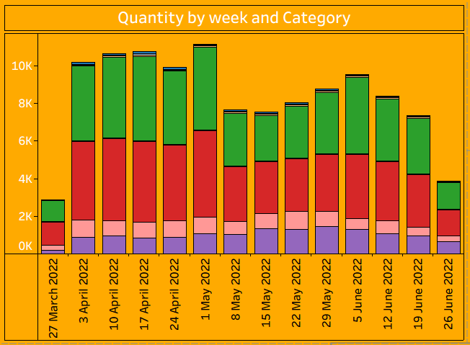
Number of items sold every week, grouped by product categories.
This bar chart shows how many products were sold each week. The different colors represent various product categories.

Slide 3
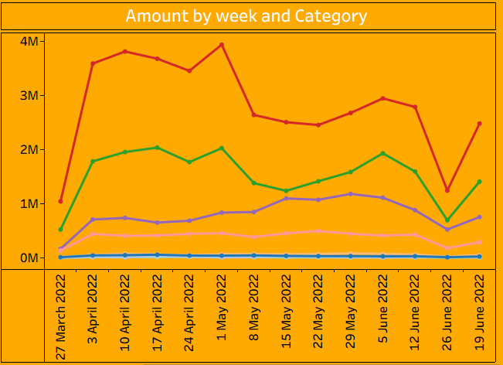
Total sales amount (in INR) each week by category.
"This line chart shows how much revenue was earned each week from different product categories."

Slide 4
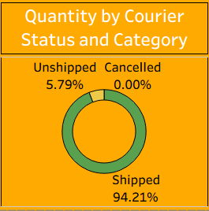
Percentage of orders that are shipped, unshipped, or cancelled.
"This pie chart shows the delivery status. Most orders are shipped, and very few are unshipped or cancelled."

Slide 5
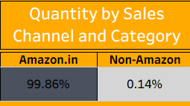
Comparison of sales on amazon.In vs non-amazon platforms.
"Almost all sales come from amazon.In, with very few from other channels."

Slide 6
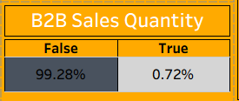
Shows how much of the sales are business-to-business (B2B).
"Only a small portion of the sales are from B2B customers. Most sales are to regular customers."

Slide 7
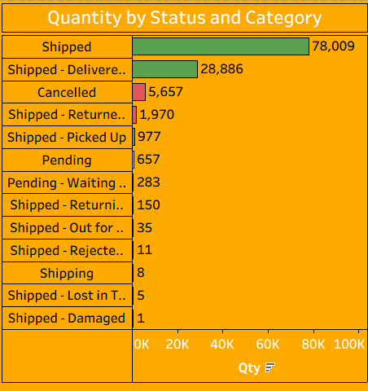
Breakdown of orders by shipping status (e.G., Shipped, cancelled, returned).
"This table gives detailed numbers on shipping statuses — like how many items were shipped, returned, cancelled, or pending."

Slide 8
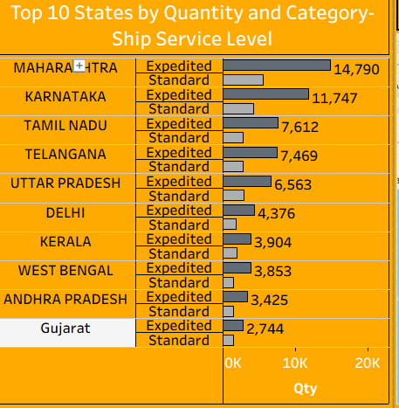
States with highest product quantities and their shipping type (standard/expedited).
"This chart shows the top states by sales quantity and the type of delivery used in each — like standard or expedited."

Slide 9
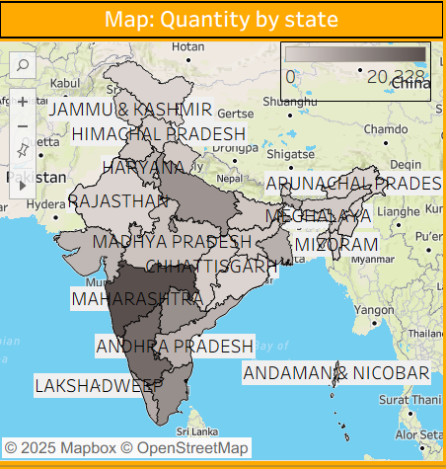
Geographic view of sales across different states in India.
"This map shows where the most orders are coming from. Darker regions have higher sales."

Slide 10
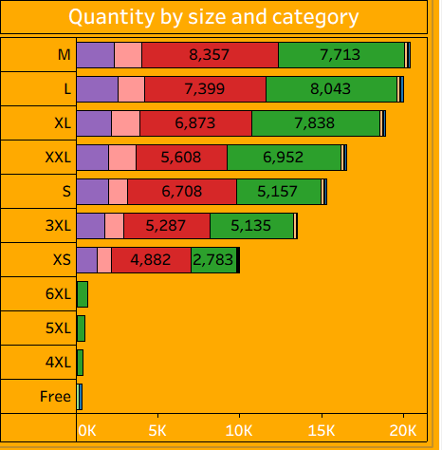
Sales quantity by product sizes (e.G., M, l, xl).
"This chart compares how many products of each size were sold. Medium and large are the most popular sizes."

Slide 11
Thank you

